Slide 1
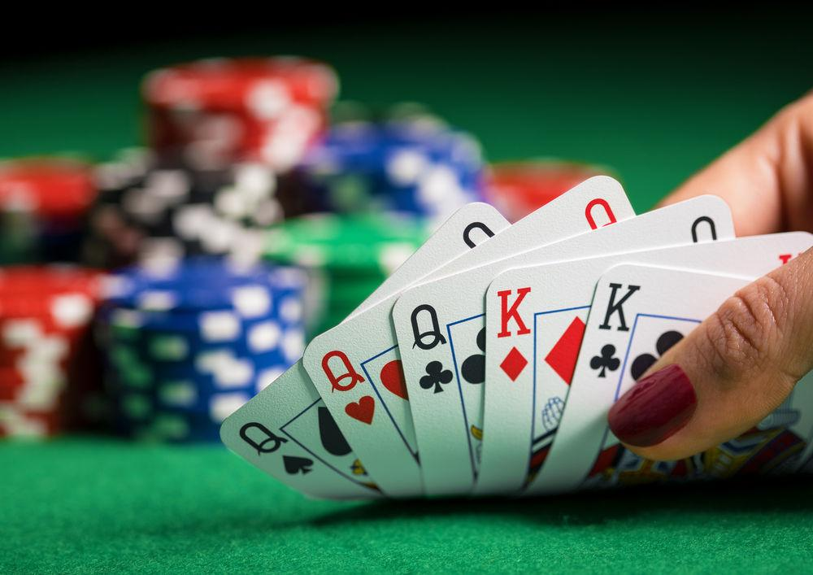
Texas Hold ‘Em Poker
King’s Disciples
Shane Staret,
Sami Dunn,
John Colbert,
Michael Heller

Slide 2
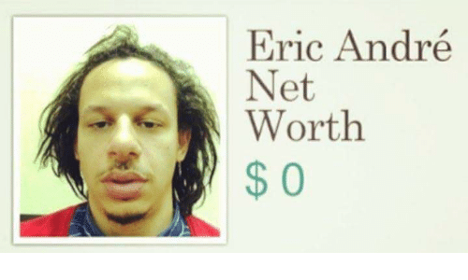
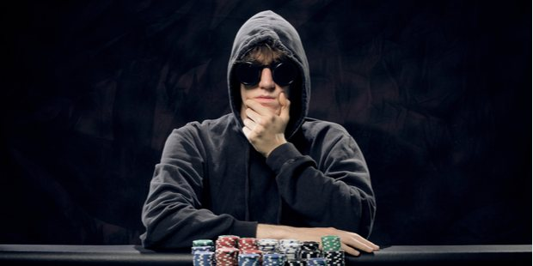
Background
Wanted a GUI based poker
Practice blowing money without actually blowing money
I’m also broke now
Let broke college students feel a little joy of spending money
Not joking I have no money now accepting donations
Venmos - samid13, michael-heller-13
Focus on making a strong poker game that worked
Good looking GUI that was user friendly
Original goal for learning AI - might try to develop basic CPU model if time allows
M

Slide 3
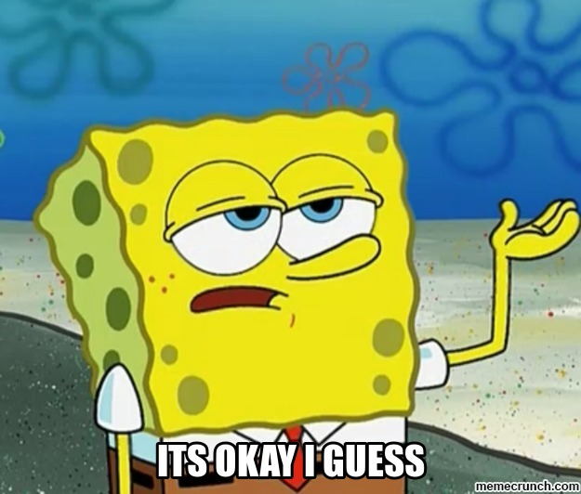
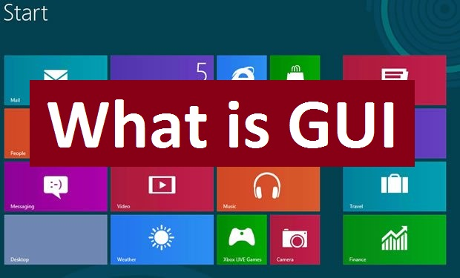
Motivation
We all liked poker (or learned to like it) (the hard way)
Liked GUI
Were confident in our abilities to finish this (YAH !!)
POKER?
S

Slide 4
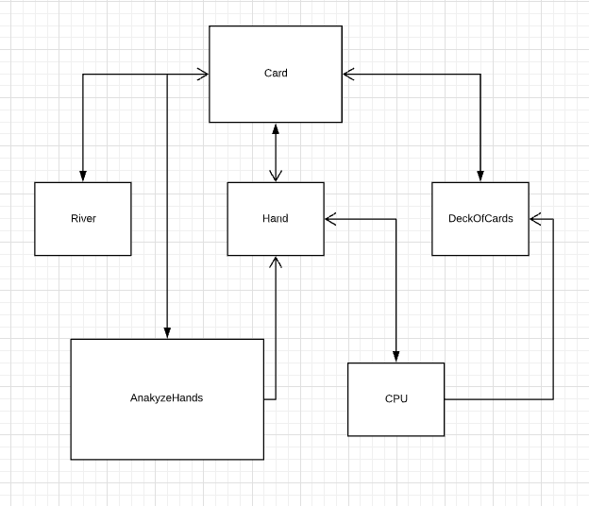
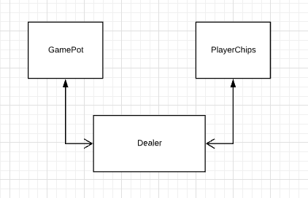
UML
J
Notes:
John

Slide 5
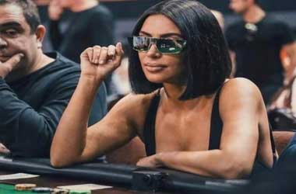
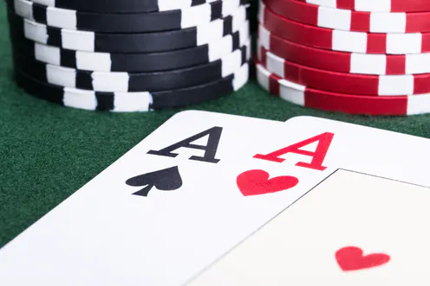
Major Classes
S/O Kim for reflective glasses
Player
Chips
Hand
Score
Card
Deck
River
Dealer
Hand analyzer
CPU AI (hopefully)
M

Slide 6
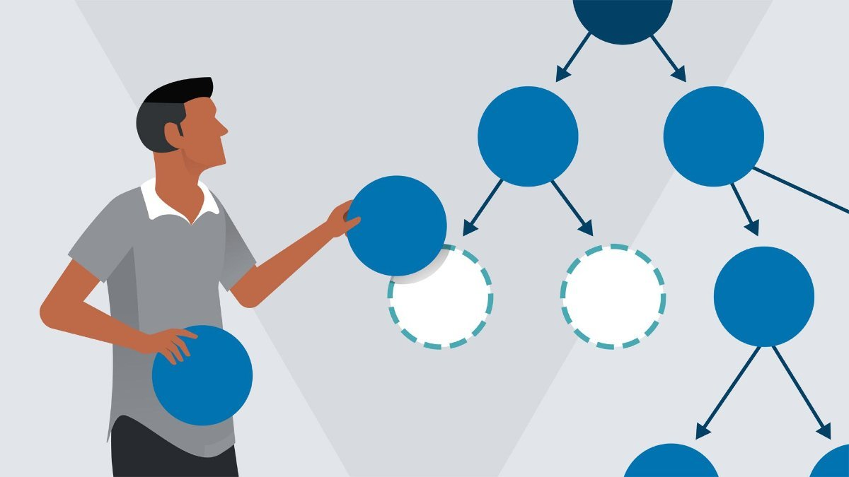
Data Structures
Notable Algorithms
Enums
ArrayLists
CPU (AI)
Levels of risk for CPU
Correlates to range of bets
More or less bluffs
Hand Analysis
Algorithm of each possible hand
M

Slide 7
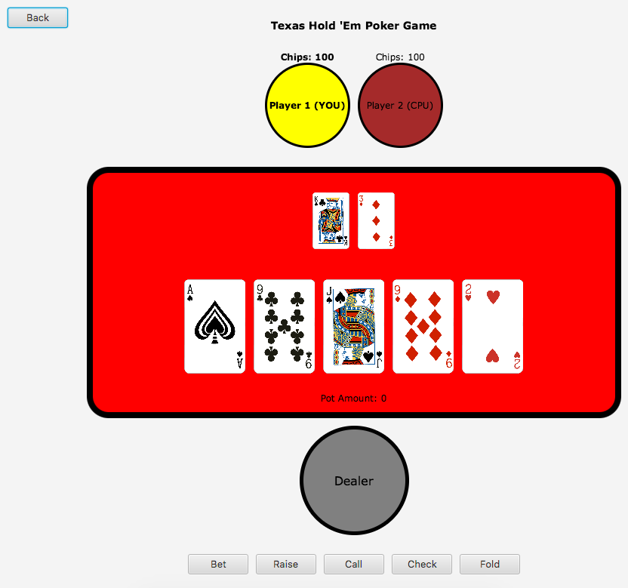
User Interface
G

Slide 8

Demonstration
G

Slide 9
SCRUM Experience - Important User Stories
Dealer user stories that allowed the turn to properly progress (flop, river, turn)
Allowing and disallowing certain player actions depending on what turn it is
Determining who wins the pot
Customization options
G

Slide 10
SCRUM - Strengths, Weaknesses, and Challenges
Strengths - A good job on properly contributing the time that we estimated
Weaknesses - Improperly estimating how much a task would take (a lot of UNDERESTIMATION)
Challenges - Properly communicating who had to do what and how we could interface everyone else’s changes without anything breaking
G

Slide 11
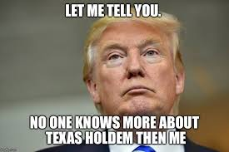
What We Learned
How to get in AND out of Git Hell (thank you ohsh*tgit.com)
Working with JavaFX to get exactly what you want where you want it
Using SCRUM to maximize team cooperation
How to play poker
J
Notes:
John

Slide 12
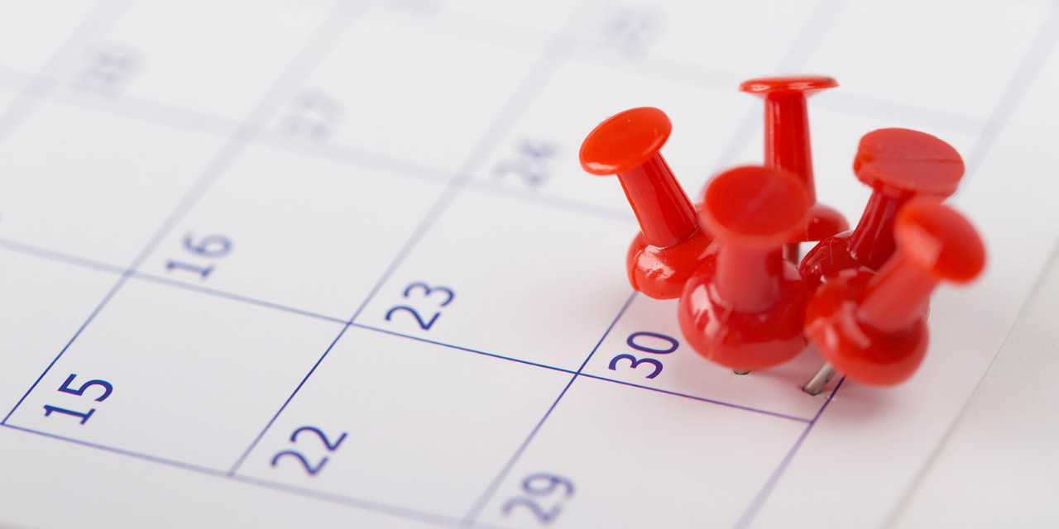
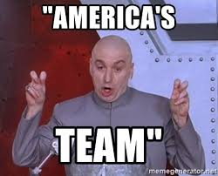
What We Would Change
Better communication
Stricter deadlines
More team meetings to collaborate where each of us are stuck
Version 2.0
Our faces when the game opens (A team dream from the start)
Smart AI to play against
Show stacks of poker chips next to each user
S

Slide 13
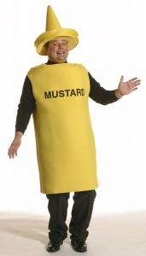
Thank you!
Dad Joke for the Road:
How do you make holy water?

